Slide 1
Department of CSE
Probability statistics and queuing theory
22MT2005
Topic:
Measures of Central Tendency and Dispersion
Session - 11

Slide 2













AIM OF THE SESSION
To familiarize students with the basic concept of measures of central tendency and dispersion
INSTRUCTIONAL OBJECTIVES
This Session is designed to:
Demonstrate the examples of mean, median and mode
Describe various measures of dispersion
List out the importance of average and variation in data analysis
Describe the important characteristics of measures of central tendency and dispersion
LEARNING OUTCOMES
At the end of this session, you should be able to:
Define mean, median and mode
Describe various measures of central tendency and variation
Summarize the role of average and variance.

Slide 3

MEASURES OF CENTRAL TENDENCY
A measure of central tendency is a single value that attempts to describe a set of data by identifying the central position within that set of data. As such, measures of central tendency are sometimes called measures of central location.
There are five different types of averages:
Mean
Median
Mode.
Geometric Mean
Harmonic Mean

Slide 4
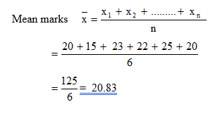
MEASURES OF CENTRAL TENDENCY
Arithmetic Mean
Arithmetic mean is also called arithmetic average. It is most commonly used measure of central tendency.
Arithmetic average of a series is the value obtained by dividing the total value of various item by its number. Mean For Ungrouped data:
Let x be the variable which takes values x₁, x₂, x₃,………,x_{n} over ‘n’ items, then arithmetic mean is given by
Example
Marks obtained by 6 students are given below: 20, 15, 23, 22, 25, 20. Calculate the mean.
Solution:

Slide 5
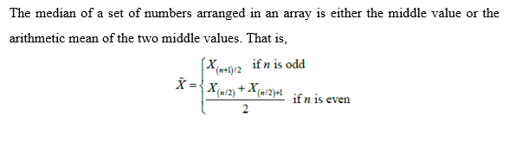
MEASURES OF CENTRAL TENDENCY
Median
The median is the middle number in a sorted, ascending or descending, list of numbers and can be more descriptive of that data set than the average.
The median is sometimes used as opposed to the mean when there are outliers in the sequence that might
skew the average of the values.
So Median is only measure of central tendency that can be used only for qualitative (ordinal) data.
Median For Ungrouped Data:

Slide 6
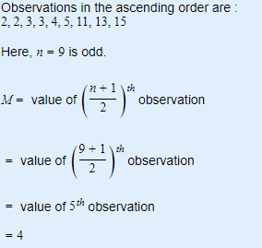
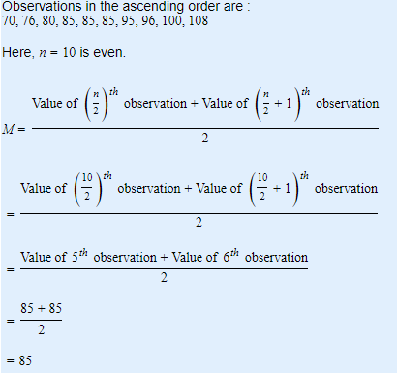
MEASURES OF CENTRAL TENDENCY
Example: Calculate Median from the following data 3,13,11,15,5,4,2,3,2
Calculate Median fom the following data 85,96,76,108,85,80,100,85,70,95

Slide 7
MEASURES OF CENTRAL TENDENCY
Mode for ungrouped data
Mode is that value of the observation which occurs maximum number of times. It is denoted by ‘z’.
Example: Calculate Mode from the following data 85,96,76,108,85,80,100,85,70,95
Solution:
In the given data the observation 85 occurs maximum number of times (i.e., 3)
Therefore Mode=85.

Slide 8
MEASURES OF CENTRAL TENDENCY
Advantages and disadvantages of each measure of central tendency
Mean
Disadvantages:
It is unduly affected by extreme items.
Advantages:
It is simple and easy to compute.
It is sometimes un-realistic.
It is rigidly defined.
It may leads to confusion.
It is amenable for algebraic manipulations.
Suitable only for quantitative data (for variables).
It is based on all observations in the series.
It cannot be located by graphical method or by observations.
It helps for direct comparison.

Slide 9
MEASURES OF CENTRAL TENDENCY
Advantages and disadvantages of each measure of central tendency
Median
Disadvantages:
Advantages:
It may not be representative value as it ignores extreme values.
It is simple, easy to compute and understandable.
It can’t be determined precisely when its size falls
between the two values.
It’s value is not affected by extreme variables.
It can be determined by inspection for arrayed data.
It is not useful in cases where large weights are to be given to extreme values.
It can be found graphically also.
It is capable not for further algebraic treatment.

Slide 10
MEASURES OF CENTRAL TENDENCY
Advantages and disadvantages of each measure of central tendency
Mode
Advantages:
Disadvantages:
Its result will not be affected by extreme values and open end classes
If data are not grouped, it can be
determined easily
It has to be supplemented by other statistics
It is difficult to obtain an accurate estimate of the
mode if the values are classified into a frequency
distribution.

Slide 11
MEASURES OF CENTRAL TENDENCY
Dispersion is the measure of the variation of the items”.----A. L. Bowely
“The term dispersion is used to indicate the facts that within a given group, the items differ from one another
in size or in other words, there is lack of uniformity in their sizes”.---W. I. King
Example:
Sections |  |  |  |  |  |  |  |  |  | Total | Mean
A | 15 | 15 | 15 | 15 | 15 | 15 | 15 | 15 | 15 | 135 | 15
B | 11 | 12 | 13 | 14 | 15 | 16 | 17 | 18 | 19 | 135 | 15
C | 3 | 6 | 9 | 12 | 15 | 18 | 21 | 24 | 27 | 135 | 15

Slide 12
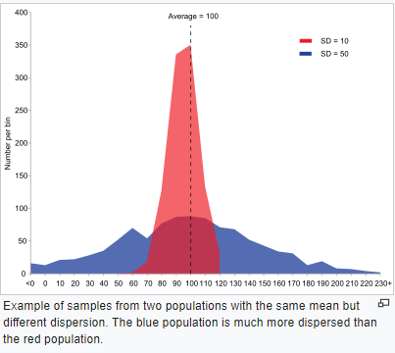
MEASURES OF CENTRAL TENDENCY
Purpose of dispersion:
To compare two or more series with regard to their variability.
To serve as a basis for the control of the variability.
To determine the reliability of average.
To facilitate the computation of other statistical measures.

Slide 13
MEASURES OF CENTRAL TENDENCY
.Properties of Good measure of dispersion
It should be simple to understand.
It is should be easy to compute.
It is should rigidly defined.
It should be based on all observations.
It should measure the sampling fluctuations.
It should be suitable for further algebraic treatment.
It should be not be affected by extreme observations.

Slide 14

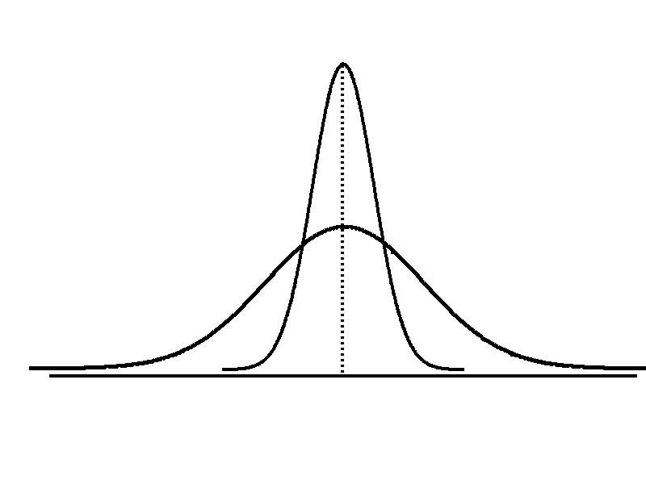
MEASURES OF Dispersion
Variation
Range
Variance
Standard
Deviation
Coefficient
of Variation
Measures of variation give information on the
spread or variability or dispersion of the data
values.

Slide 15
MEASURES OF Dispersion
Range
Simplest measure of variation
Difference between the largest and the smallest values:
^{Range = X}largest ^{– X}smallest
Variance
Average (approximately) of squared deviations of values from the mean
Sample variance:
σσ^{n}
xx_{ii} −− xx
2
X = arithmetic mean n = sample size
𝑆²² =
ii==11
𝑜𝑟
𝑛𝑛
_{σ}n
x_{i} − x
2
X = i^{th} value of the variable X
𝑆² =
i=1
i
𝑛 − 1

Slide 16
MEASURES OF Dispersion
Example
Sample Data (X_{i}) :
10 12 14 15 17 18 18 24

Slide 17

ACTIVITIES/ CASE STUDIES/ IMPORTANT FACTS RELATED TO THE SESSION
Case Study 1:
Find the Variance and Standard Deviation of the Following Numbers: 1, 3, 5, 5, 6, 7, 9, 10.
The mean = 46/ 8 = 5.75
Step 1: (1 – 5.75), (3 – 5.75), (5 – 5.75), (5 – 5.75), (6 – 5.75), (7 – 5.75), (9 – 5.75), (10 – 5.75)
= -4.75, -2.75, -0.75, -0.75, 0.25, 1.25, 3.25, 4.25
Step 2: Squaring the above values we get, 22.563, 7.563, 0.563, 0.563, 0.063, 1.563, 10.563, 18.063
Step 3: 22.563 + 7.563 + 0.563 + 0.563 + 0.063 + 1.563 + 10.563 + 18.063
= 61.504
Step 4: n = 8, therefore variance (σ²) = 61.504/ 8 = 7.69 (3sf)
Now, Standard deviation (σ) = 2.77 (3sf)

Slide 18
ACTIVITIES/ CASE STUDIES/ IMPORTANT FACTS RELATED TO THE SESSION
Case Study 2:
The length of 20 similar crystals is measured (in mm) in a chemistry experiment. Calculate the standard deviation and the
coefficient of variation for the observations taken.
Crystal no. | Length (mm) | Crystal no. | Length (mm)
1 | 9 | 11 | 7
2 | 2 | 12 | 4
3 | 5 | 13 | 12
4 | 4 | 14 | 5
5 | 12 | 15 | 4
6 | 7 | 16 | 10
7 | 8 | 17 | 9
8 | 11 | 18 | 6
9 | 9 | 19 | 9
10 | 3 | 20 | 4

Slide 19
ACTIVITIES/ CASE STUDIES/ IMPORTANT FACTS RELATED TO THE SESSION
Solution : We can construct the table as given below
Crystal no. | Length (mm) | Crystal no. | Length (mm)
1 | 9 | 2 | 4
2 | 2 | -5 | 25
3 | 5 | -2 | 4
4 | 4 | -3 | 9
5 | 12 | 5 | 25
6 | 7 | 0 | 0
7 | 8 | 1 | 1
8 | 11 | 4 | 16
9 | 9 | 2 | 4
10 | 3 | -4 | 16
11 | 7 | 0 | 0
12 | 4 | -3 | 9
13 | 12 | 5 | 25
14 | 5 | -2 | 4
15 | 4 | -3 | 9
16 | 10 | 3 | 9
17 | 9 | 2 | 4
18 | 6 | -1 | 1
19 | 9 | 2 | 4
20 | 4 | -3 | 9
N = 20 | ∑ x_{i} = 140 |  | ∑ (x_{i} – A)² = 178
A = ∑ x_{i} / N = 140/20 = 7 mm
Now, we may give the Standard Deviation as –
σ(X −A)²
178
S.D.=
i
=
N
20
=2.9832(mm)
We can calculate the coefficient of variation as –
C.V.=(S.D./A)×100
=(2.9832/7)×100
=42.62 percent
CREATE
D BY K. VICTOR BABU

Slide 20


EXAMPLES
Example: The runs scored by Sachin in 5 test matches are 140, 153, 148, 150 and 154 respectively. Find the mean.
Runs scored by Sachin in 5 test matches: 140, 153, 148, 150 and 154
Means of the runs = total runs number of matches/5 Mean = 140+153+148+150+1545 = 7455/5 = 149.
Example: Suppose a restaurant collects the cans for two weeks and sends it to a recycling plant. The number of cans collected each day are: 84, 97, 77, 31, 84, 58, 63, 72, 47, 84, 64, 94, 43 and 68.
Now we need to find the median of these numbers. The first step to find the median is to arrange the numbers either in ascending order of descending order.
So arranging the data in the ascending order, 31, 43, 47, 58, 63, 64, 68, 72, 77, 84, 84, 84, 94 and 97. Here the total numbers are even. So using the formula
Median = ((n/2)^{th} + (n/2+1)^{th} terms)/2
Since n = 14, 7th term = 68 and 8thterm = 72. Now we have our two middle terms as 68 and 72, hence Median = 68+722 = 70.

Slide 21


SUMMARY
Described measures of central tendency Mean, Median and Mode
Described measures of variation
Range, interquartile range, variance and standard deviation, coefficient of variation,

Slide 22




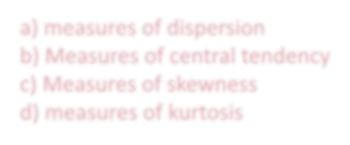


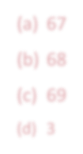
SELF-ASSESSMENT QUESTIONS
The measurements of spread or scatter of the individual values around the central point is called
measures of dispersion
Measures of central tendency
Measures of skewness
measures of kurtosis
The mean of an examination is 69, the median is 68, the mode is 67, and the standard deviation is 3. The
measures of variation for this examination is
67
68
69
3

Slide 23

TERMINAL QUESTIONS
Describe various measures of central tendency and dispersion
List out the characteristics of good average
Summarize the role of descriptive statistics in data analysis
For the following list, n = 19. Find the median.
24, 25, 28, 31, 33, 33, 36, 42, 42, 48, 51, 57, 57, 68, 75, 79, 79, 79, 85
Five people play golf and at one hole their scores are 3, 4, 4, 5, 7 For these scores, find (a) the mean (b) the median (c) the mode (d) the range .

Slide 24

REFERENCES FOR FURTHER LEARNING OF THE SESSION
Reference Books:
Chapter 1 of TP1: William Feller, An Introduction to Probability Theory and Its Applications: Volume 1, Third Edition, 1968 by John Wiley & Sons,Inc.
Richard A Johnson, Miller& Freund’s Probability and statistics for Engineers, PHI, New Delhi, 11th Edition (2011).
Sites and Web links:
Section 3.1.1 of TS1: Alex Tsun, Probability & Statistics with Applications to Computing (Available at:
http://www.alextsun.com/files/Prob_Stat_for_CS_Book.pdf)
Video: https://www.youtube.com/watch?v=- 5sOBWV0qH8&list=PLeB45KifGiuHesi4PALNZSYZFhViVGQJK&index=19

Slide 25

THANK YOU
Team – PSQT EVEN SEM 2023-24

